Slide 1


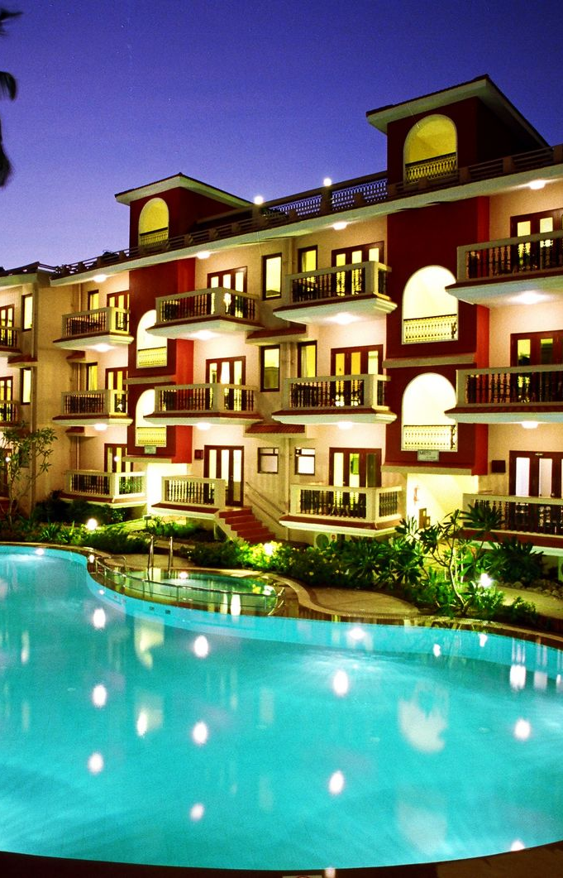
HOTEL MANAGEMENT
TEAM ACHIEVERS
Sridharan R
Sushmitha K
Tino Jebison Y
Vaishnavisripriya G
Varshini R
Vignesh V
This Photo by Unknown author is licensed under CC BY-NC-ND.

Slide 2
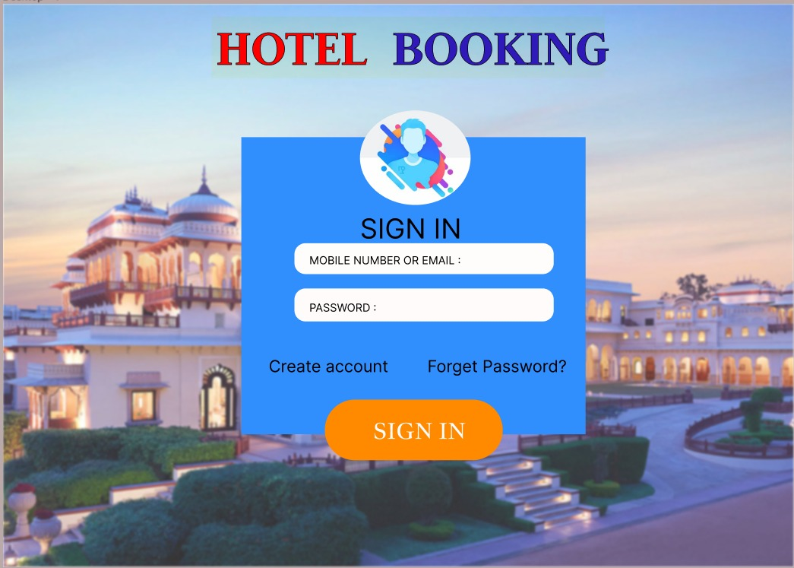

Slide 3
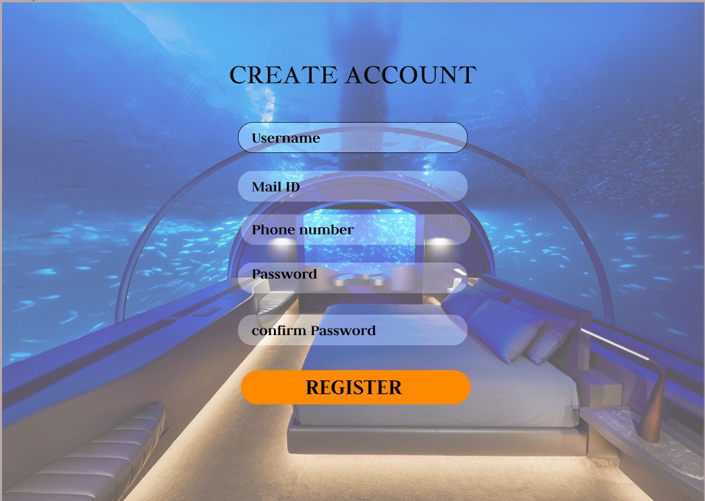

Slide 4
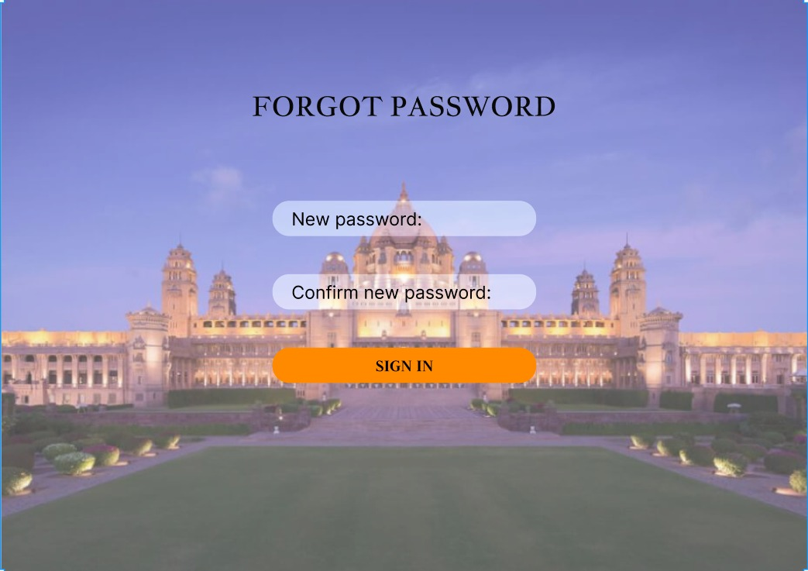

Slide 5
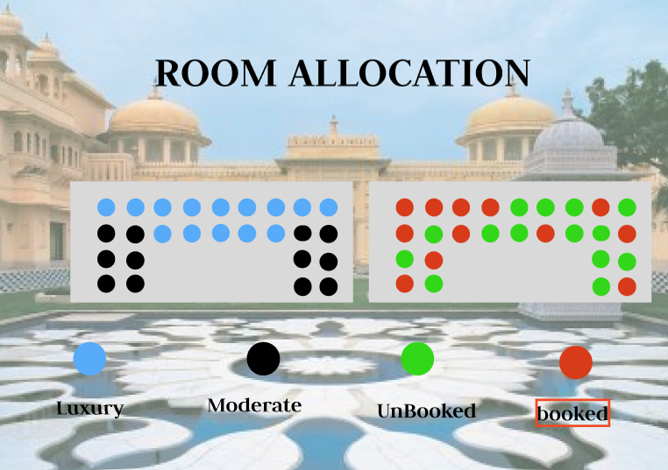

Slide 6
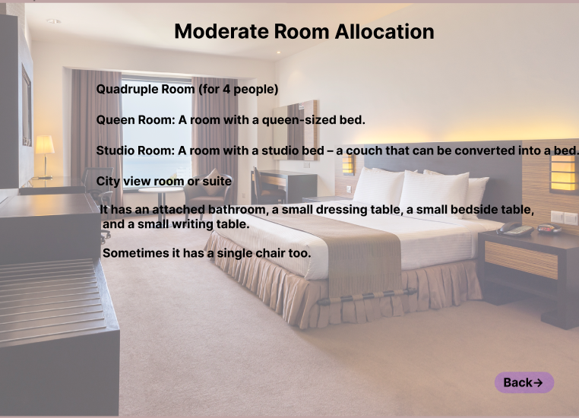

Slide 7
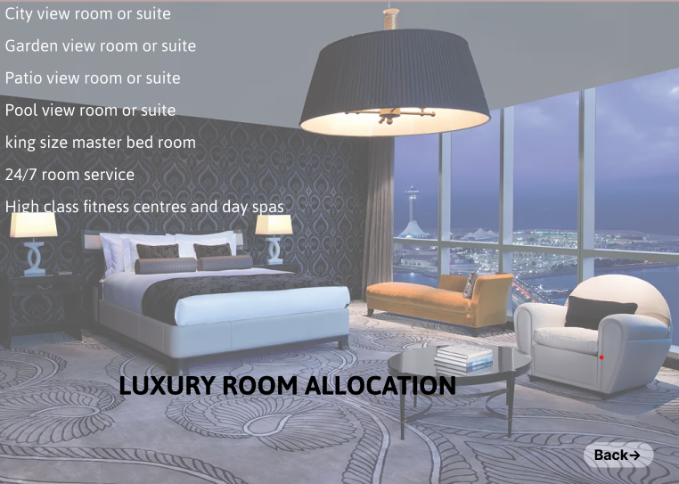

Slide 8
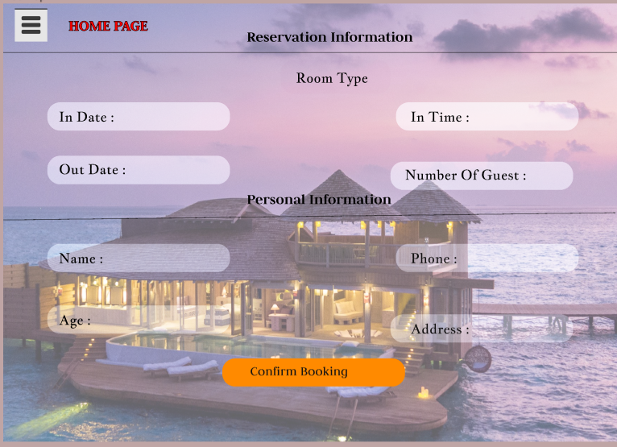

Slide 9


Slide 10

LINK
Figma File
GITHUB LINK:
https://github.com/Sridharan2104

Slide 11
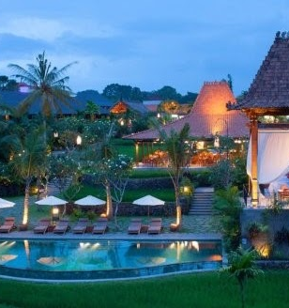
THANK YOU.....!
This Photo by Unknown author is licensed under CC BY.

